Slide 1
Effort Reporting Fundamentals
Jaquion Gholston
Central Administrator

Slide 2
Learning Objectives
What is effort reporting
Why is it necessary
What are the guiding principles governing effort commitment and effort certification
What is ERS and how does it work?

Slide 3
EFFORT REPORTING
Sponsored Grants & Contracts
Active Awards – Over 500
Federal
$180,709,921
Non Federal
$101,801,190

Slide 4
EFFORT REPORTING
University Effort Reporting Periods
Faculty Effort Reporting Periods:
Spring (January 1 – May 7)
Summer (May 8 - August 23)
Fall (August 24 - December 31)
Academic = 8.5 calendar months & Summer = 3.5 calendar months
Staff (including Grad Assistants) Effort Reporting Periods:
Spring (January 1 - May 7)
Summer (May 16 - August 15)
Fall (August 16 - December 31)

Slide 5
EFFORT REPORTING
Effort is defined as the amount of time spent on a particular activity. It includes the time spent working on a sponsored project in which salary is directly charged or contributed (cost-share). Effort reporting is the mandated method of certifying to the granting agencies that the effort charged or cost shared to each award has actually been completed.

Slide 6
Federal Requirements
The federal government requires an effort report when an individual is compensated by or has agreed to contribute time to a federally sponsored project. All faculty who serve as Principal Investigators (PI) on sponsored agreements are personally responsible to ensure the amount of effort that they and their employees spent on sponsored activities is certified.

Slide 7
Risk of Not Complying
Institutional disallowances can result if:
The effort report was certified by an individual other than the employee or someone who has "first-hand" knowledge of 100 % of the employee’s time.
The effort report does not encompass all of the activities performed by the employee under the terms of their employment.
The levels of effort reported do not appear reasonable, given the responsibilities of the individual.
Individual disallowances can result if:
The effort report certified by the individual is found to be falsified.
The levels of effort reported do not appear reasonable.
Federal audit disallowances can result in serious financial and reputational penalties for the University.

Slide 8
Definitions
Committed Effort. Proportion of effort explicitly devoted to a sponsored activity.
100% effort is the total effort expended by an employee in the performance of institutional duties.
All effort (activities) must total 100%, even though the appointment may be less than 1 FTE.

Slide 9
Definitions
Effort distribution. The allocation of one’s time to various activities. Distribution likely will vary within and across departments..
25% Project A Sponsored Activity - %50
25% Project B
40% Teaching Institutional Activity - %50
10% Service (Includes grant writing, which is not allowed as direct cost)
& Admin
100% effort

Slide 10
Definitions
Effort certification. Documentation by individual or someone with suitable means of verification (direct knowledge) that effort reported is a reasonable reflection of work performed.
Associated costs charged represent actual costs.

Slide 11
Why is it necessary?
Condition of receiving federal funding
Federal regulations
Office of Management and Budget (OMB) Circular A-21
http://www.whitehouse.gov/omb/circulars/a021/a21_2004.html
j. 10. Compensation for personal services.
Other regulations: OMB A-110, A-133, etc
Fed’s want to know
They got what was promised
They got what they paid for
They didn’t get harmed

Slide 12
The Regulations require that…
Adhere to all applicable federal regulations
and
An institution adhere to its own policies

Slide 13
The Regs require that…
Effort, for all Sponsored & Institutional activities, is to be confirmed by the employee.
In some cases effort may be confirmed by responsible person with suitable means of verification that the work was performed
At SU – all exempt employees certify their own effort.

Slide 14
The Regs require that…
Costs charged represent actual costs.
Charges for effort on a sponsored project (or institutional account associated with sponsored project) were
fairly made,
accurate, and
recorded in a timely manner.

Slide 15
The Regs require that…
Direct charges to chart string may originally be based on estimates. However, costs charged must be actual costs.
When estimates are used, significant changes (i.e. 5% of effort distribution category) in the corresponding work activity must be identified and entered into the payroll distribution system.
Short term (1 or 2 months) fluctuation between workload categories need not be considered as long as the distribution of salaries and wage is reasonable over the longer term, such as academic period

Slide 16
Key steps in the ER process - #1 Understanding your work load and
Effort Distribution.
What is your baseline effort distribution?
What does SU expect and pay you for?
40% R, 40% T, 20% S ??
30% R, 60% T, 10% S ??
Other distribution
# courses in pct teaching?

Slide 17
Key steps in the ER process - #1 Understanding your work load and
On average how do you actually spend your time?
25 hr R, 15 hr T, 15 hr S = 55 h/wk
Effort reporting is not about tracking hours worked, but the employee needs to have a general sense of average work load to estimate effort distribution.
~45% R, ~27% T, ~27% S

Slide 18
Your baseline institutional effort distribution
Have conversation with chair / dean…
Are all expectations in alignment?
Teaching load? (# courses per semester)
Research productivity?
External funding ??
Service – committee assignments etc
Understanding your effort distribution is foundation of accurate effort reporting.
Document baseline effort distribution.
May change annually or more frequently.

Slide 19
Key steps in the process - #2 Introducing sponsored activities
Proposal development –
You are making a commitment to the sponsor to work a specific level of effort on a project.
Commitment – reasonable level to conduct project given resources / time (duration) available.

Slide 20
Considerations
What’s on your plate?
Will everything (effort distribution) stay the same?
Add sponsored to everything else? or
Give something up?
Sponsors may assume ‘proportion of institutional duties ‘constant’ unless adjustments documented …
Nature of ‘work plan’ → how much “time” needed to accomplish goals and objectives (proportion of all duties?)
What does sponsor expect

Slide 21
Why reflect on effort commitments at proposal development?
Written promise becomes condition of award….
UNLESS explicitly modified and documented during agreement negotiations.
Avoid over commitment (sponsor not getting fair deal)

Slide 22
Where & when is effort committed?
When applications or proposals are submitted…
Budget and budget narrative
PI will devote 25% academic year and 100% summer effort to the project. Only summer effort will be charged to the grant. Cost-sharing
Project coordinator will devote 50% effort throughout the calendar year
1 summer-month support is requested

Slide 23
Key steps in the process - #3 Honoring your commitment
At notice of award → reflect:
Proposed commitment realistic in context of all duties?
No over commitment?
Other considerations? (leave, course relief?)
If okay → modify appointment – iJAN
iJan → translate effort to payroll…
If not → contact OSP to negotiate new commitment to sponsor.

Slide 24
Key steps in the process - #3 Honoring your commitment
Monitor project.
Regular reflection – commitment (aka payroll) = ‘reasonable estimate’ of work performed?
Adjust after the fact – PAR
Adjust in anticipation of change or when new effort distribution occurs – iJAN
REMEMBER: reductions in effort for an extended period of time (e.g. 3 months or 25% reduction from feds) require prior approval from sponsor.
Reasonable estimate..

Slide 25
What about summer effort?
Not institutional effort BUT part of annual budget / work plan to sponsor…
Rate of pay can not exceed rate from IBS.
Only sponsor can benefit.
Effort certified is expressed percent of compensation received.
Effort always totals 100%.
Check ‘payroll’ to confirm if FTE less than 1.0.

Slide 26
What about extra service or overload?
Inclusion should be noted on OSP Internal Routing and Review form – signed by individual’s chair or supervisor.
Explicitly requested in budget and justified in budget narrative if cost-reimbursable funding.
Statement need not be included in fixed price contracts, but must be clear from internal backup documentation.
Overload or extra service requested after the award has been received ordinarily requires sponsor approval.

Slide 27
Certifying effort
Based on knowledge/reflection
After each semester – all exempt personnel asked to review effort committed to each award → does effort reported reflect effort worked in the context of all institutional duties and appropriately charge?
Yes – Certify
No – adjust (work with budget manager)

Slide 28
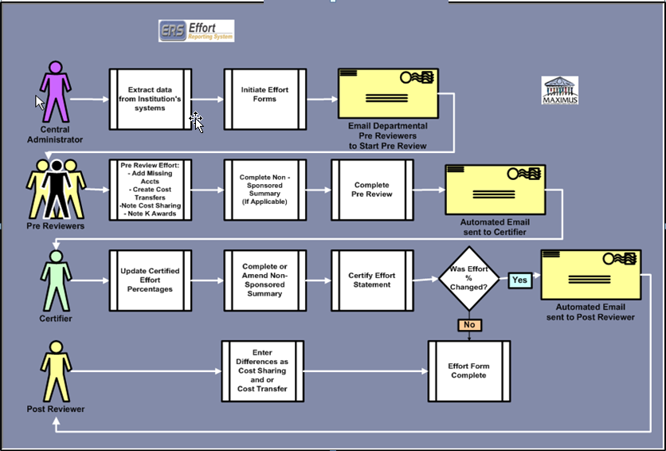
Electronic Effort Reporting – ERS Flow Chart

Slide 29
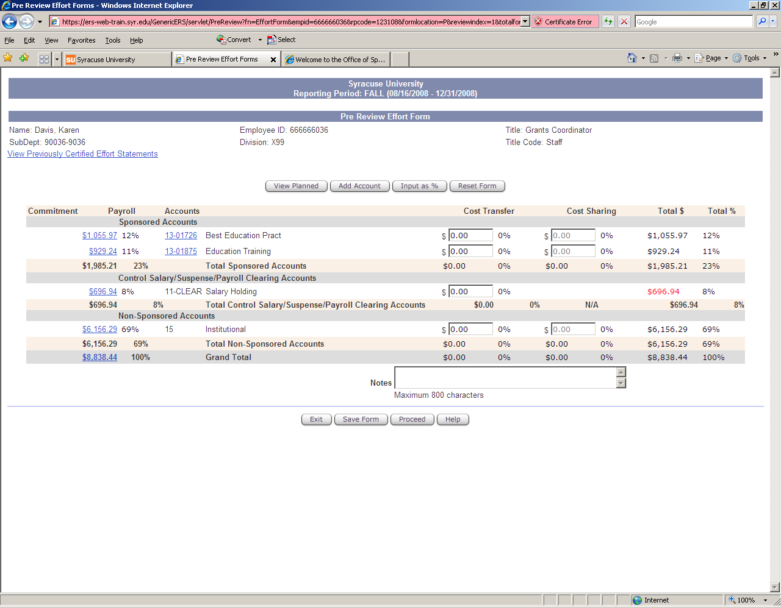

Slide 30
Progress to Date
2008 Fall Certification Period Go - Live
January 12, 2008
60 Days
568 out of 568 forms completed
100%
2009 Spring Certification Period
30 Days
590 out of 590 forms completed
100%

Slide 31
Benefits of ERS
Timely submission of effort certifications
Timely and accurate submission of payroll reallocations
Cost transfer processed through ERS during certification window.
Electronic cost transfers outside ERS at all other times!!

Slide 32
Contact Information
Proposal commitment questions
OSP
Award negotiation; post award modifications
OSP
Effort certification procedures
Jaquion Gholston X1762; jgholsto@syr.edu
Questions? ospoff@syr.edu, conacct@syr.edu

Slide 33
Syracuse University
Questions?

