Slide 1
Grants Reporting Project
OSP Awareness Session
April 9, 2015

Slide 2
Grants Reporting Project
The Grants Reporting Project Tool has been developed by a cross-functional team of Principal Investigators (PIs), Departmental Administrators, ITS Developers, ITS Project Manager, Financial Systems Management Business Analysts, and members of the Offices of Research, Sponsored Accounting, and Sponsored Programs. Some of the key goals of this project include: 1) provide accurate award summary information at a glance, 2) provide the ability to drill down into further detailed views, 3) reduce administrative time needed, as compared to the current manual process of pulling reports from multiple sources, and 4) eliminate or greatly reduce the need for shadow systems, by pulling multiple data sources into a single reporting tool.
Some features of the new report are:
Award and Project Summaries based on your access and categorized by the OSP Budget template category
Forward Funded Details and links to the Award Notes and Award Brief
Drillable links from the Award/project to the transaction level data
Burn Rate Indicator, burn rates with/without commitments, allowable remainder
Links to HR Appointment Data and PO Inquiry
Budget Scenarios that can be modified for “what-if” analysis
Salary Summary by employee
Participant Costs can be limited by name
Equipment tag numbers will be available on transaction detail level
Filters and Sorts for efficient data retrieval
Data is exportable to pdf and Excel
The tool is currently under construction and has been preliminarily tested and approved by the cross-functional team for concept and content in its first iteration of project development.

Slide 3
Grants Reporting Project
Accessing the Grants Reporting Project Tool:
The links to the reports will be found on your Myslice Page within the Financial Services Pagelet. Access to the tool is dependent upon your current security level for Grants.
Award and Project Summary Reports will be available to the following users:
Departmental Administrators who currently have award level access in FAST
Award PI
The links on Myslice will appear as follows:
Project Summary Reports will be available to the following users:
Project PIs
Project Managers
Departmental Administrators who currently have project level access in FAST
The link on Myslice will appear as follows:

Slide 4
Grants Reporting Project
Additional Notes on Payroll Summary Access:
The link for Budget Category by Employee Summary will not be available.
When clicking on expended account code links (column highlighted), user will receive the message: “You are currently not authorized to access payroll detail information for this project.”
This is different than the current Sponsored Project Expenditure Report (SPER), which only allows access to those users that have payroll detail security.

Slide 5
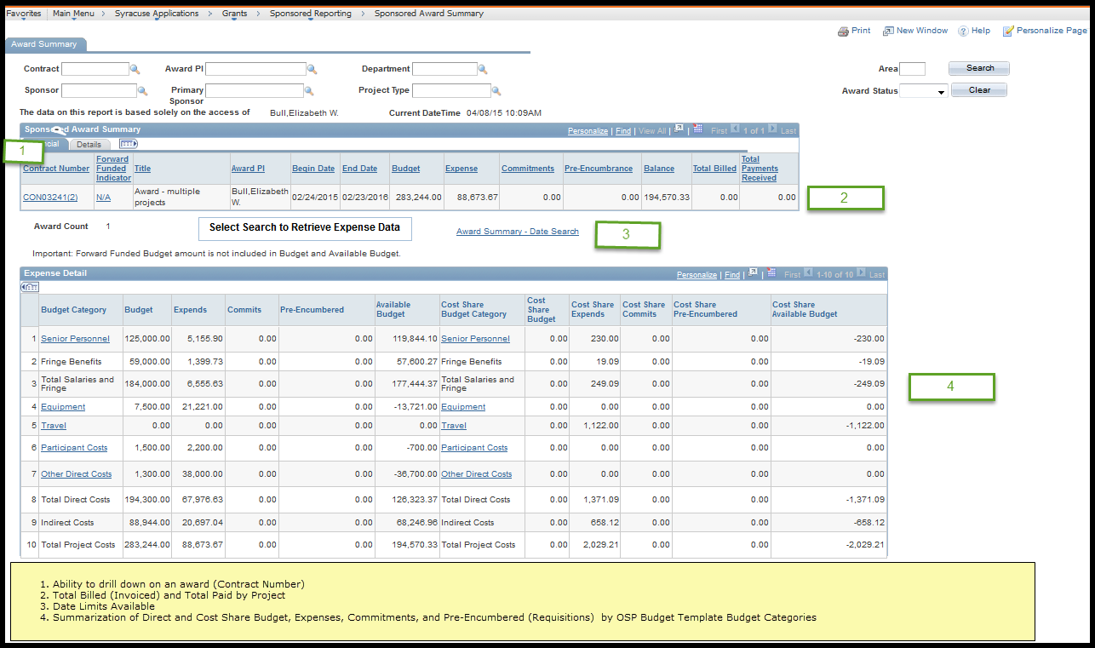
Grants Reporting Project
Award Summary
Financial Tab:

Slide 6
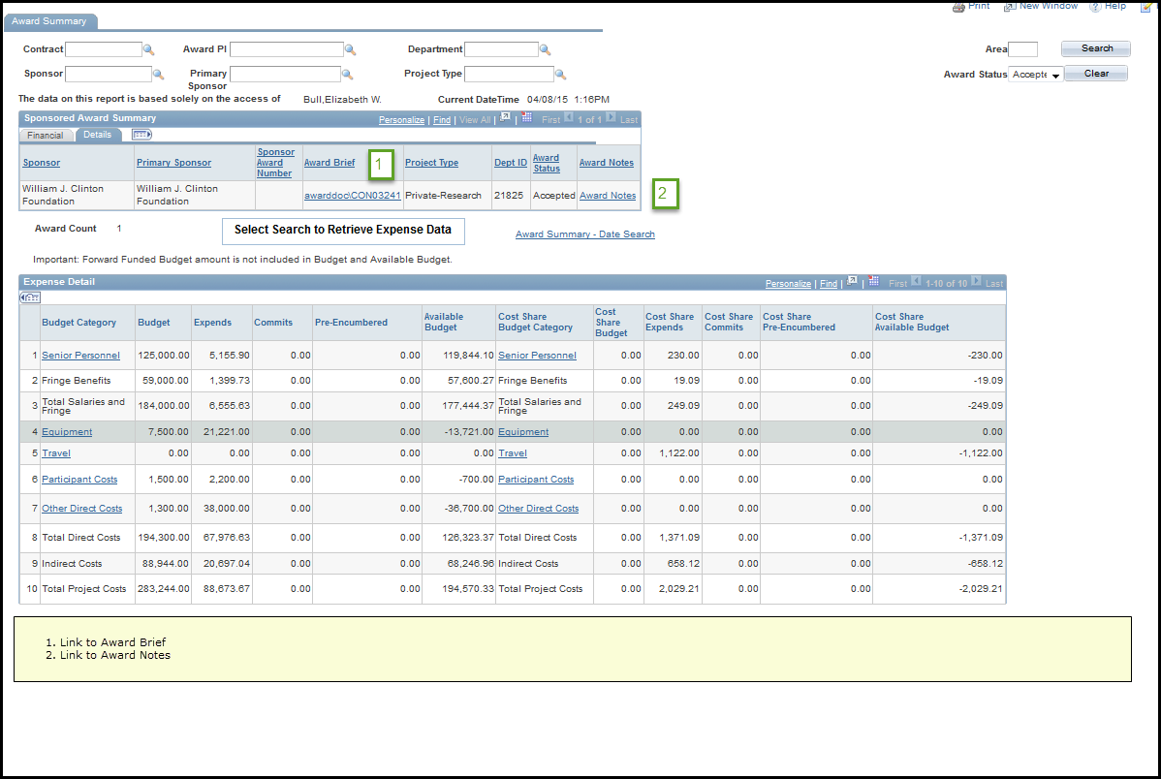
Grants Reporting Project
Details Tab:

Slide 7
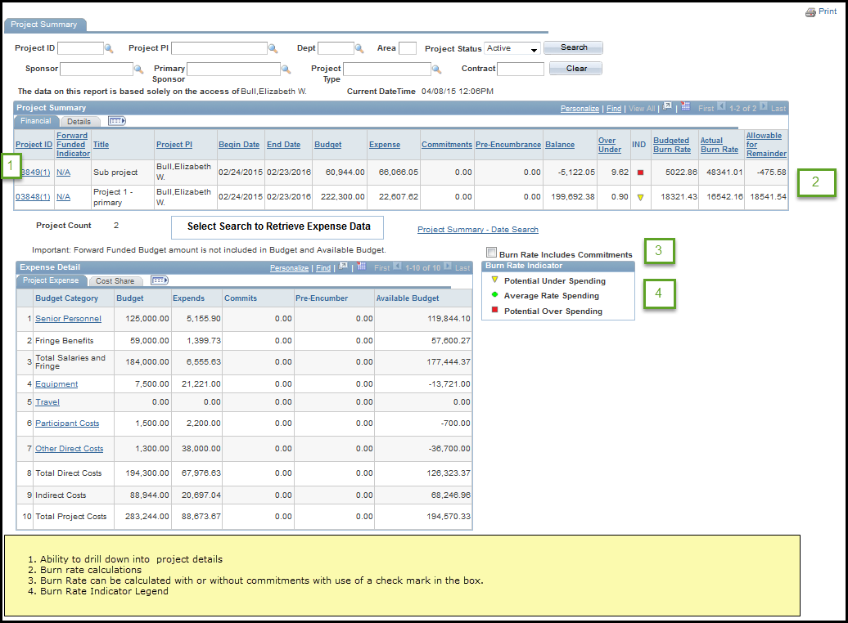
Grants Reporting Project
Project Summary
All users with project or award level security will have the ability to view a summary of all projects for which they have access.
Financial Tab:

Slide 8
Burn Rate Calculations Without Commitments (Box unchecked):
Budgeted Burn Rate: Total funded budget / ((project end date- project begin date)/30)
Actual Burn Rate:
If project end date has passed:
Total expenditures (Actuals, F&A, Fringe) / ((project end date- project begin date)/30)
Otherwise:
Total expenditures (Actuals, F&A, Fringe) / ((Today-project start date) / 30)
Allowable Burn Rate for Remainder:
If Today > (project end date = 90 days):
Default to 0
If ( (project end date – today) /30 ) < 1
Default to (Total Budget –Total Expenditures)
Otherwise:
(Total Budget –Total Expenditures) / ((project end date – today) / 30)
Over/Under:
(Actual_burn_rate / budgeted_burn_rate)

Slide 9
Burn Rate Calculations With Commitments (Box checked):
Budgeted Burn Rate: Total funded budget / ((project end date- project begin date)/30)
Actual Burn Rate:
If project end date has passed:
Total (Expenditures + Commitments) / ((project end date- project begin date)/30)
Otherwise:
Total (Expenditures + Commitments) / ((Today-project start date) / 30)
Allowable Burn Rate for Remainder:
If Today > (project end date = 90 days):
Default to 0
If ( (project end date – today) /30 ) < 1
Default to (Total Budget – (Total Expenditures + Commitments))
Otherwise:
(Total Budget – (Total Expenditures + Commitments) / ((project end date – today) / 30)
Over/Under:
(Actual_burn_rate / budgeted_burn_rate)

Slide 10
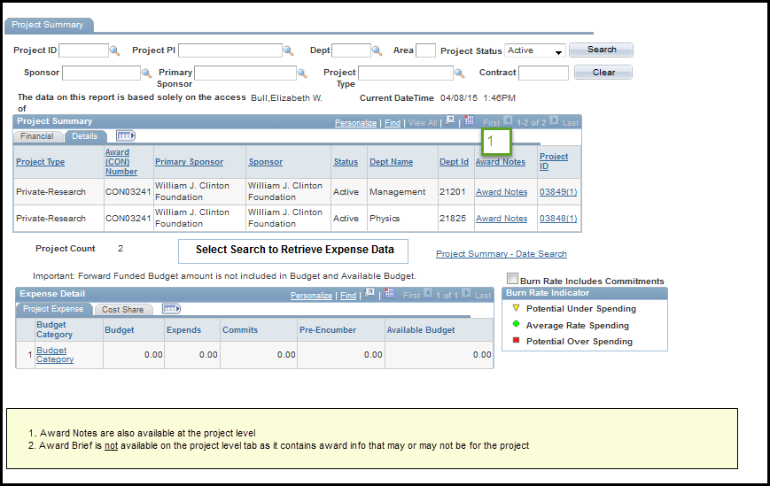
Grants Reporting Project
Details Tab:

Slide 11
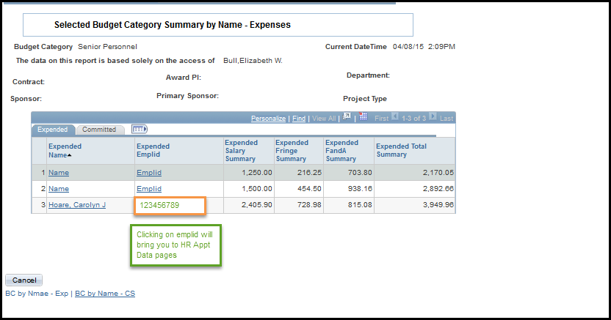
Grants Reporting Project
Links to HR Appointment Info:
Note: This access is only available to those users who currently have payroll detail access to a project/award and HR access to appointment data

Slide 12
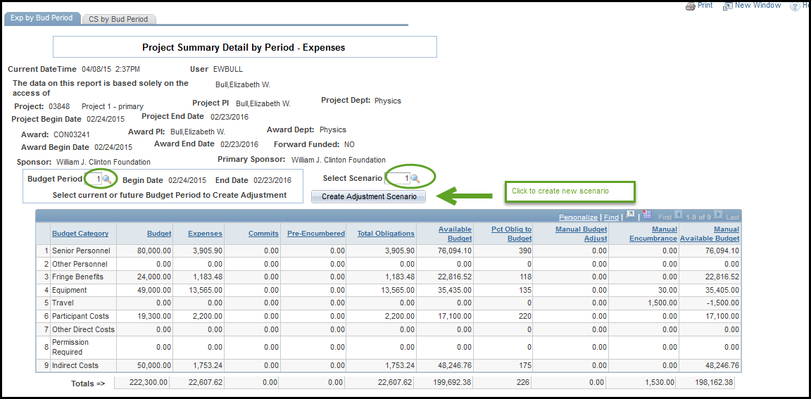
Grants Reporting Project
Budget Scenarios that can be modified for what-if analysis:
Note: Adjustments to budgets or encumbered expenses on the scenarios do not affect financials. These will not be fed to financials nor will they be reported except via this report. This is strictly to be used as a forecasting tool.
Grants Reporting Project

Slide 13
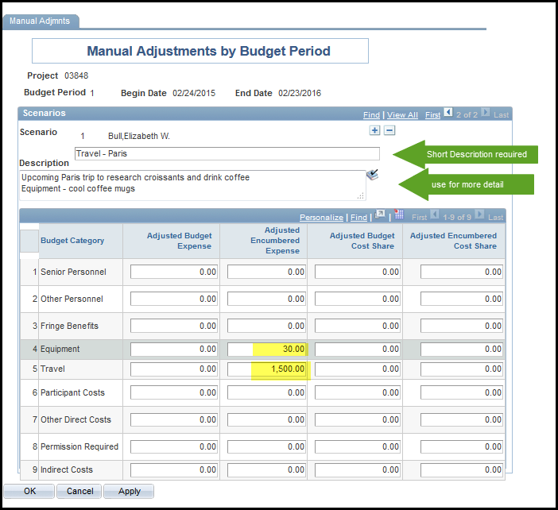
Grants Reporting Project
Example of budget scenario detail that appears on prior page:
This is viewable by other project team members but they cannot modify. If they wanted to make a change (for instance, in this case move the coffee mug expense to Other Direct costs) they would need to create a different scenario.

Slide 14
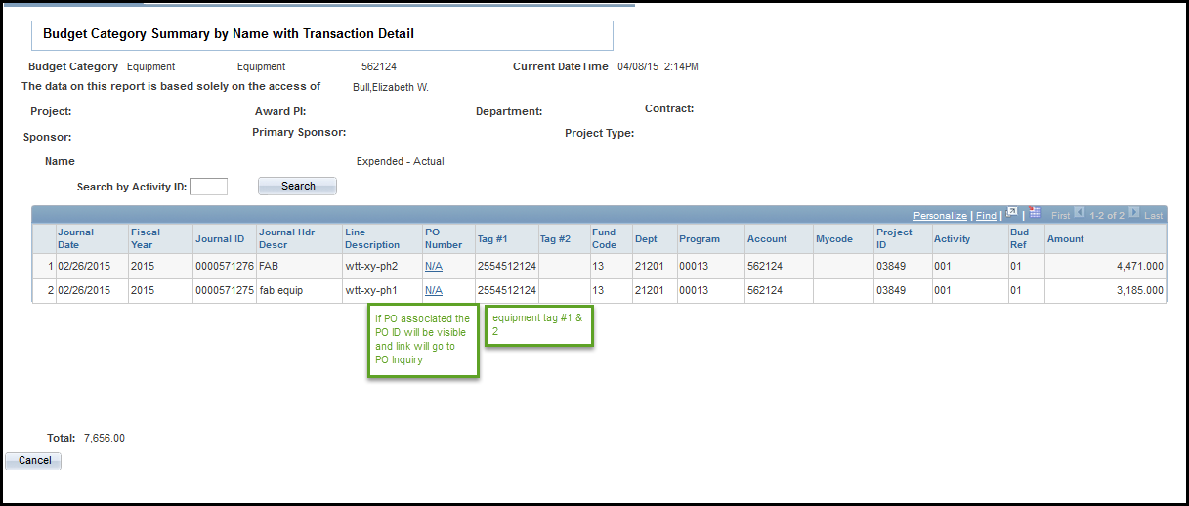
Grants Reporting Project
PO inquiry link and Equipment tag detail:

Slide 15
Grants Reporting Project
The Grants Reporting tool will allow you to slice and dice the data in a number of ways. From viewing your awards at a highly summarized level down to looking at row-level transactions, there will be ways to analyze your project data.
If you would be interested in participating in the next round of reviews please send an email to Carolyn Hoare (cjhoare@syr.edu), Karen Chilson (kmchilso@syr.edu), and Susan Watts (scwatts@syr.edu) stating that you would like to join in the Grants Reporting project regression testing. This is scheduled to take place in June and July.
Thank you for joining us today!
Your presenters,
Karen Chilson
Carolyn Hoare

