Slide 1
Traveling on Sponsored Projects: how to ensure smooth and safe travels
Office of Sponsored Programs
Office of Sponsored Accounting
March 18, 2015
ospoff@syr.edu

Slide 2
Begin at the proposal process (ideally)
Budgeting and justifying travel should happen at proposal submission
Ask yourself “Why do I or others need to travel on this award?”
Answers will vary depending on the type of award, but some typical answers could be:
To disseminate project results
Conferences, annual meetings, etc.
To conduct the work of the award/research
Perform field-work
Meet with collaborators at their work site
Host off site or international conferences, etc.
Bring collaborators to campus

Slide 3
Sponsor and SU guidelines come into play at proposal
“Travel” encompasses the following (and sometimes more):
Planes, trains and automobiles (typically economy class)
Lodging
Conference registration
Meals eaten while traveling
Other necessary expenses (SU and sponsor guidelines apply)
Justification (details needed for proposal submission)
Why are people traveling, who are those people, what is needed to get them there, where are they traveling to, how are they getting there and how will it benefit the award?
External party travel (co-collaborators from other institutions or others traveling for the benefit of the award)must follow SU’s policies and sponsor guidelines

Slide 4
The final details of budget creation
Before submitting your proposal to OSP:
Check proposal/sponsor terms & conditions, are there specific travel restrictions or travel cost guidelines?
Special provisions?
Ensure that proposed travel, i.e. conferences, events, occur with the award timeframe
Determine budget estimates using published rates, travel search engines, recent experience or, best of all, a travel agent!
Our advice: carefully consider all possibilities when planning for travel costs, and make sure the principle of reasonableness is employed.

Slide 5
Once awarded, how does travel occur?
Ready, set, travel!
Use of University credit card may make travel more convenient, ask your department administrator or Dean’s office about getting one of your very own
Travel advances are available to SU employees, and permit the traveler to receive cash prior up front, prior to traveling, to cover expenditures during the trip
Travel Advances are provided to employees only, typically the principal investigator or other key award personnel
To get a travel advance, complete the travel advance form and submit to Sponsored Accounting at least two weeks prior to the scheduled departure
Travel insurance may be allowable, ask your OSA senior accountant for details
Seat upgrades within the same class (typically economy) are typically allowable on sponsored awards, no medical justification is necessary
Class upgrades, like economy to business class, require pre-authorization and sometimes medical justification, contact OSA to discuss
Questions about your specific situation? Call OSA or OSP to discuss

Slide 6
It’s all in the details….
What’s allowable on sponsored travel? Well, it depends on a lot of factors. Below are some specific clarifications on common travel questions.
Meals for anyone not on travel status (meals for SU employees or students while not on travel status, such as eating out in Syracuse)
Alcoholic beverages
Meals for SU employees and students may be allowable while not on travel status when connected with a day long conference or event
Lodging for PI and employees not on travel status (exceptions can apply, ask OSP for assistance in determining this at budget submission)
Questions about your specific situation? Contact OSA for help

Slide 7
Managing your travel
When you return you will have to complete the following:
A reconciliation of your travel expenses (if you had an advance)
and/or submit your University JPMC card reconciliation
and/or submit a travel voucher (request for reimbursement of your personal funds expended during the travel period for which you did not receive an advance)
Request and keep receipts for anything and everything possible
If receipts are not possible (for a native guide, for example), keep track of your exact expenditures on a daily basis, this will make the reconciliation much easier
It is permissible to take a “picture” of your receipts and email to your department administrator (or yourself) for submission to your area’s approver and OSA
The “picture” receipts will need to be printed out and submitted with your reconciliations when you return from your travel
If currency conversions are necessary Convert currency to US:
http://www.oanda.com/currency/historical-rates/

Slide 8
International Travel
Traveling abroad
First order of business, sign up for International SOS
It’s free to all University employees and students
It’s for YOUR convenience and protection
Contact OSP or Risk Management for SU’s membership ID#
Traveler safety & security
Check U.S. Dept of State travel advisories prior to booking travel and departure
http://travel.state.gov/content/passports/english/alertswarnings.html
Approval from University executives may be needed for countries/regions listed as per SU travel policy
Fly America Act and Open Skies Agreements (EU)
Use travel agent (e.g., BTI) to ensure compliance with provisions
Document search engine results if not through travel agent
Secure OSP approval for concurrence of exceptions before travel

Slide 9
What is the Fly America act?
In a nutshell:
Generally, if a traveler is traveling on funds provided by the federal government she/he must use a U.S. flag carrier (an airline owned by an American company), regardless of cost or convenience.
If you are scheduling federally funded international travel, you must ensure that all flights, where possible, are scheduled on U.S. flag carriers or on foreign air carriers that code share with a U.S. flag carrier.
Code sharing occurs when two or more airlines “code” the same flight as if it was their own. In other words, a U.S. airline may sell a seat on the plane of a foreign airline; this seat is considered the same as one on a plane operated by a U.S. flag carrier.
Fly America does not apply when flying between or within foreign countries when U.S. flag carriers are not an option

Slide 10
Code sharing?
US Flag Carriers or code share partners
What is a code-share carrier?
A. A code-share carrier provides seats for another airline on its regularly scheduled flights. Many US airlines have code-share arrangements with other US as well as foreign carriers (e.g., Delta with Air France). Proof of code-share travel is indicated on your ticket stub or documentation for electronic tickets by use of the US air carrier’s designator code and flight number (e.g., UA# on a Lufthansa flight).
The following are US Flag carriers (as of 3/15, not to be used as a comprehensive list or source, check with OSP or OSA)
Airtran Airways (FL) Alaska Airlines (AS)
American Airlines (AA) Delta Airlines (DL)
Frontier Airlines (F9) Hawaiian Airlines (HA)
Southwest Airlines (WN) Spirit Airlines (NK)
United Airlines (UA) US Airways (US)

Slide 11
Open Skies Agreement
An exception to the Fly America Act is the Open Skies Agreement
The United States and European Union have an (EU) “Open Skies” Air Transport Agreement
This means that travelers whose travel is supported by federal funds, may travel on EU airlines as well as U.S. Flag Air Carriers in certain situations, to specific destinations and on certain carriers
Allows travelers using federal funds to fly point to point on an EU carrier (or other carrier from the countries noted below) from the U.S. to:
EU Countries (plus Norway & Iceland)
Australia
Switzerland
Japan
* Exception for Australia, Switzerland, and Japan may occur if a GSA City Pair Agreement exists, check with OSP or OSA if you have questions.

Slide 12
Export Controls
Export Controls
If you are bringing ‘stuff’ abroad, contact OSP early for guidance
OSP will need to analyze country requirements for items on commerce control list and munitions lists (e.g., GPS, cameras, etc.)
Analysis can be complicated and takes time to perform properly
Licenses, if required by the US government, can take a few months to acquire, so please, plan ahead and contact OSP as soon as you know you will be traveling internationally with equipment of any kind
Traveling with Computers: Using the TMP or BAG Exceptions
Travel to most countries usually does not constitute an export issue
Taking a laptop with only Microsoft Office Suite, Internet Explorer, etc. is OK to most countries, without a license. Make sure to remove encrypted software, or other sensitive data from the laptop first.
It is an Export issue if taking information, equipment or computers to embargoed countries (e.g. Cuba, Syria, Iran, North Korea, Sudan, others evolve over time, check with OSP).

Slide 13
ITAR/EAR
Fundamental Research Exclusion (ITAR, EAR)
No license is required for fundamental research, defined as basic or applied research in science or engineering:
At an accredited U.S. college or university; and
Information/ results are typically published and shared broadly in the scientific community
Please Note: The university gives up the Fundamental Research Exclusion in research agreements that:
Give sponsors the right to restrict the publication of research results; or
Prevents the participation of foreign nationals in the research

Slide 14
ISOS Services
Medical Services
Security Services
Emergency evacuation
Medically-supervised repatriation
Additional travel and accommodation arrangements after medical evacuation
Repatriation of mortal remains
Medical monitoring
Inpatient admission and identification of receiving physician
Emergency and routine medical advice
Pre-trip information on travel health issues
Medical and dental referrals
Outpatient case management
Outpatient medical expense guarantee and payment
Dispatch of medication and medical supplies
Urgent and non-urgent travel security assistance and advice by telephone
Daily online and email updates on the latest travel security developments
Special Advisory emails with advice in response to significant travel security incidents
Security and travel information on 220 countries and more than 330 cities
Access to security evacuation
Coordination of post-evacuation debriefs and counseling

Slide 15
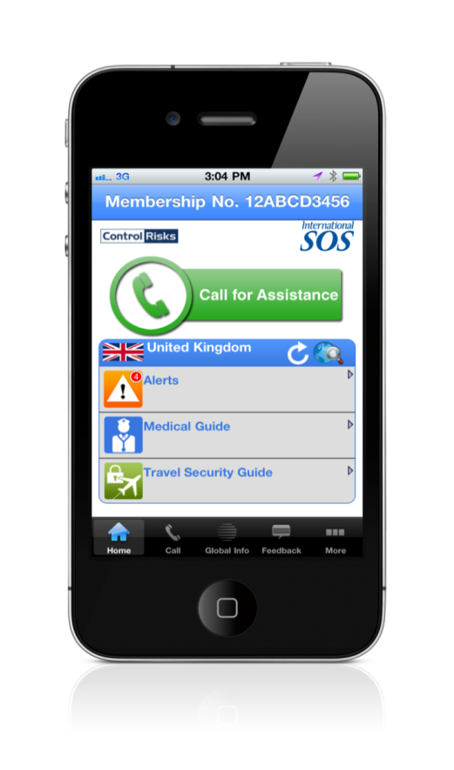
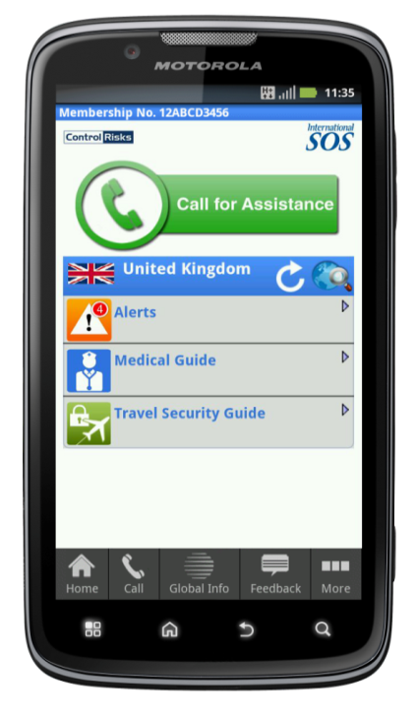
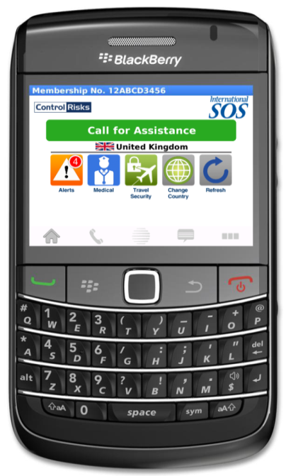
The Membership App
The App is a service benefit and is available as part of your membership.
Download from http://app.internationalsos.com

